Slide 1


e
Mini project on ‘PHONEBOOK APPLICATION’ in c language

Slide 2
Index
Introduction.
Aim of the project.
Advantages & Disadvantages.
Design.
Modules.
Output
Conclusion

Slide 3
Introduction
Phonebook is a very simple mini project in C that can help you understand the basic concepts of functions, file handling, and data structure. This application will teach you how to add, list, modify or edit, search and delete data to/from the file.
Adding new records, listing them, modifying them and updating, searching for contacts saved, and deleting the phonebook records are the basic functions that make up the main menu of this Phonebook application.

Slide 4
Personal information such as name, gender, phone number,email and address are asked while adding a record into the Phonebook. These records can then be modified, listed, searched for and removed.
I have used many functions in this mini project. These functions are easy to understand as their name only signifies their respective operations.

Slide 5
Aim of the project
To develop a “Phonebook contact” application using c programming.
This program is very useful nowadays to store complete information under a single contact number.
This program also has options for deletion and modification of the entered contact number.

Slide 6
Advantages & Disadvantages
For It becomes easy for the user to store complete information( i.e e-mail id, address) about his contact.
It is easy for the user to just search his required contact number by just typing the name of the contact.
Some times it becomes difficult to store more contacts(i.e over 150)
It becomes even difficult to store contacts with two or more contact numbers.

Slide 7
Design
The present program consists of the following modules:
Preprocessor commands.
Structures.
Functions
Variables
Statements & Expressions.

Slide 8
Module -1(Header files)
#include<stdio.h>
#include<conio.h>
#include<string.h>
#include<stdlib.h>
#include<windows.h>

Slide 9
Module-2(declaring structure & functions)
struct person
{
char name[35];
char address[50];
char father_name[35];
char mother_name[30];
long int mble_no;
char sex[8];
char mail[100];
char citizen_no[20];
};
void menu();
void got();
void start();
void back();
void addrecord();
void listrecord();
void modifyrecord();
void deleterecord();
void searchrecord();

Slide 10
Module-3(main function)
This function displays the user to select his choice of operations.
void menu()
{
system("cls");
printf("\t\t*****WELCOME TO PHONEBOOK****");
printf("\n\n\t\t\t MENU\t\t\n\n");
printf("\t1.Add New \t2.List \t3.Search \n\t4.Modify \t5.Delete\t6.Exit");
switch(getch())
{
case '1':
addrecord();
break;
case '2': listrecord();
break;

Slide 11
case '3':searchrecord() ;
break;
case '4': modifyrecord();
break;
case '5':deleterecord() ;
break;
case '6':exit(0) ;
break;
default:
system("cls");
printf("\nEnter 1 to 6 only");
printf("\n Enter any key");
getch();
menu();
}

Slide 12
Module -4(adding contacts)
void addrecord()
{
system("cls");
FILE *f;
struct person p;
f=fopen("project","ab+");
printf("\n Enter name: ");
got(p.name);
printf("\nEnter the address: ");
got(p.address);
printf("\nEnter father name: ");
got(p.father_name);
printf("\nEnter mother name: ");
got(p.mother_name);
printf("\nEnter phone no.:");
scanf("%ld",&p.mble_no);
printf("Enter sex:");
got(p.sex);
printf("\nEnter e-mail:");
got(p.mail);

Slide 13
printf("\n\nEnter any key");
getch();
system("cls");
menu();
}
printf("\nEnter citision no:");
got(p.citision_no);
fwrite(&p,sizeof(p),1,f);
fflush(stdin);
printf("\nrecord saved");
fclose(f);

Slide 14
Module-5(list record)
void listrecord()
{
struct person p;
FILE *f;
f=fopen("project","rb");
if(f==NULL)
{
printf("\nfile opening error in listing :");
exit(1);
}
while(fread(&p,sizeof(p),1,f)==1)
{
printf("\n\n\n YOUR RECORD IS\n\n ");
printf("\nName=%s\nAdress=%s\nFather name=%s\nMother name=%s\nMobile no=%ld\nSex=%s\nE-mail=%s\nCitizen no=%s",p.name,p.address,p.father_name,p.mother_name,p.mble_no,p.sex,p.mail,p.citision_no);
getch();
system("cls");
}

Slide 15
fclose(f);
printf("\n Enter any key");
getch();
system("cls");
menu();
}

Slide 16
Module -6(Searching record)
void searchrecord()
{
struct person p;
FILE *f;
char name[100];
f=fopen("project","rb");
if(f==NULL)
{
printf("\n error in opening\a\a\a\a");
exit(1);
}
printf("\nEnter name of person to search\n");
got(name);
while(fread(&p,sizeof(p),1,f)==1)
{
if(strcmp(p.name,name)==0)

Slide 17
{
printf("\n\tDetail Information About %s",name);
printf("\nName:%s\naddress:%s\nFather name:%s\nMother name:%s\nMobile no:%ld\nsex:%s\nE-mail:%s\nCitision no:%s",p.name,p.address,p.father_name,p.mother_name,p.mble_no,p.sex,p.mail,p.citision_no);
}
else
printf("file not found");
}
fclose(f);
printf("\n Enter any key");
getch();
system("cls");
menu();
}

Slide 18
Module-7(Deleting record)
void deleterecord()
{
struct person p;
FILE *f,*ft;
int flag;
char name[100];
f=fopen("project","rb");
if(f==NULL)
{
printf("CONTACT'S DATA NOT ADDED YET.");
}
else
{
ft=fopen("temp","wb+");
if(ft==NULL)
printf("file opaning error");
else
{
printf("Enter CONTACT'S NAME:");
got(name);
fflush(stdin);

Slide 19
while(fread(&p,sizeof(p),1,f)==1)
{
if(strcmp(p.name,name)!=0)
fwrite(&p,sizeof(p),1,ft);
if(strcmp(p.name,name)==0)
flag=1;
}
fclose(f);
fclose(ft);
if(flag!=1)
{
printf("NO CONACT'S RECORD TO DELETE.");
remove("temp.txt");
}

Slide 20
else
{
remove("project");
rename("temp.txt","project");
printf("RECORD DELETED SUCCESSFULLY.");
}
}
}
printf("\n Enter any key");
getch();
system("cls");
menu();
}

Slide 21
Module-8(modifying search)
void modifyrecord()
{
int c;
FILE *f;
int flag=0;
struct person p,s;
char name[50];
f=fopen("project","rb+");
if(f==NULL)
{
printf("CONTACT'S DATA NOT ADDED YET.");
exit(1);
}
else
{
system("cls");
printf("\nEnter CONTACT'S NAME TO MODIFY:\n");
got(name);
while(fread(&p,sizeof(p),1,f)==1)
{
if(strcmp(name,p.name)==0)
{

Slide 22
printf("\n Enter name:");
got(s.name);
printf("\nEnter the address:");
got(s.address);
printf("\nEnter father name:");
got(s.father_name);
printf("\nEnter mother name:");
got(s.mother_name);
printf("\nEnter phone no:");
scanf("%ld",&s.mble_no);
printf("\nEnter sex:");
got(s.sex);
printf("\nEnter e-mail:");
got(s.mail);
printf("\nEnter citizen no\n");
got(s.citision_no);
fseek(f,sizeof(p),SEEK_CUR);
fwrite(&s,sizeof(p),1,f);
flag=1;
break;
}

Slide 23
fflush(stdin);
}
if(flag==1)
{
printf("\n your data id modified");
}
else
{
printf(" \n data is not found");
}
fclose(f);
}
printf("\n Enter any key");
getch();
system("cls");
menu();
}

Slide 24
void got(char *name)
{
int i=0,j;
char c,ch;
do
{
c=getch();
if(c!=8&&c!=13)
{
*(name+i)=c;
putch(c);
i++;
}
if(c==8)
{
if(i>0)
{
i--;
}

Slide 25
system("cls");
for(j=0;j<i;j++)
{
ch=*(name+j);
putch(ch);
}
}
}while(c!=13);
*(name+i)='\0';
}

Slide 26
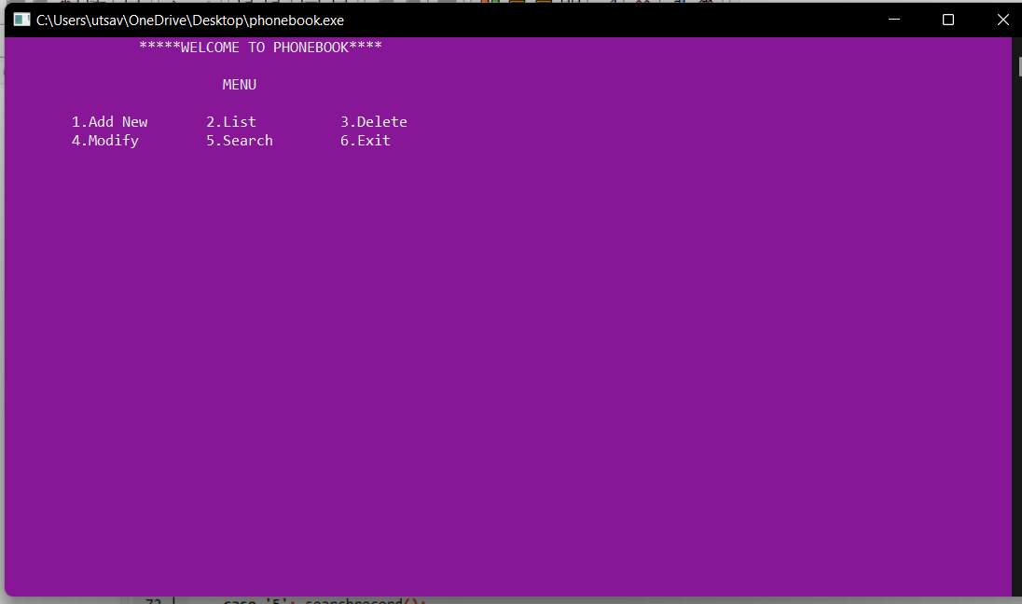
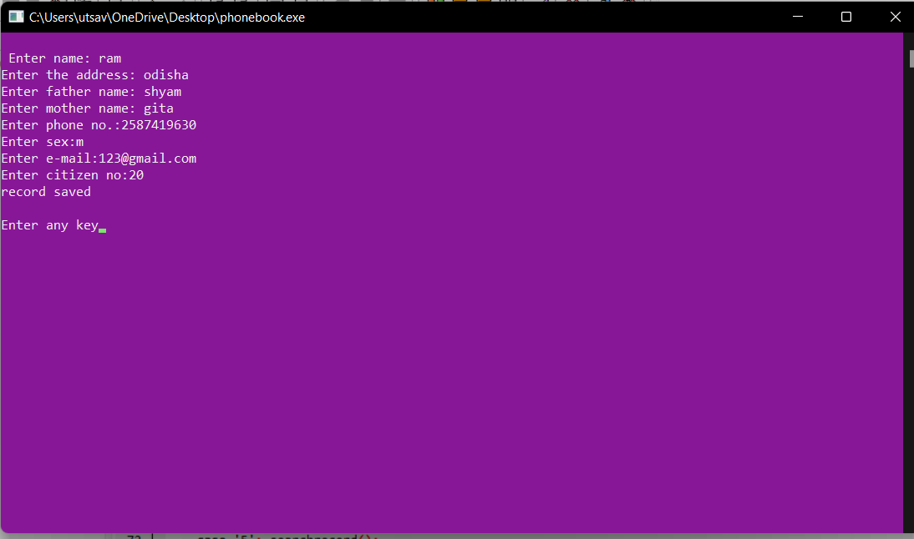
OUTPUT

Slide 27
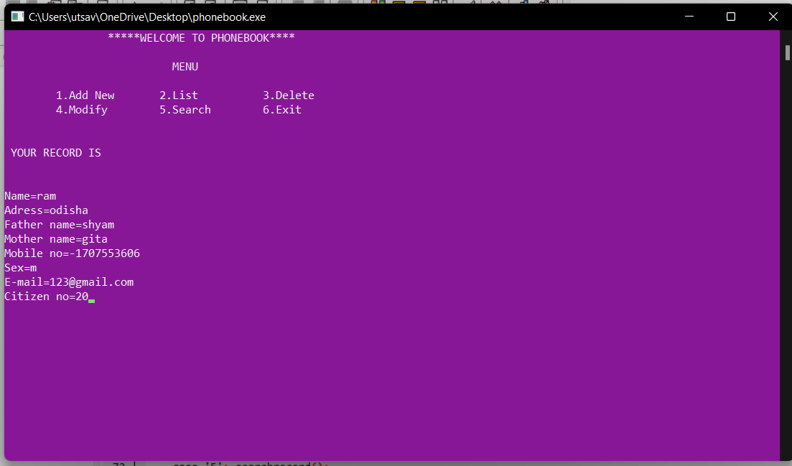
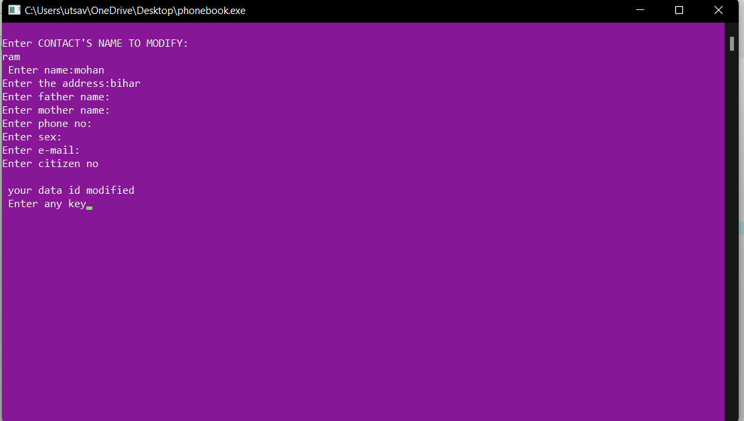

Slide 28
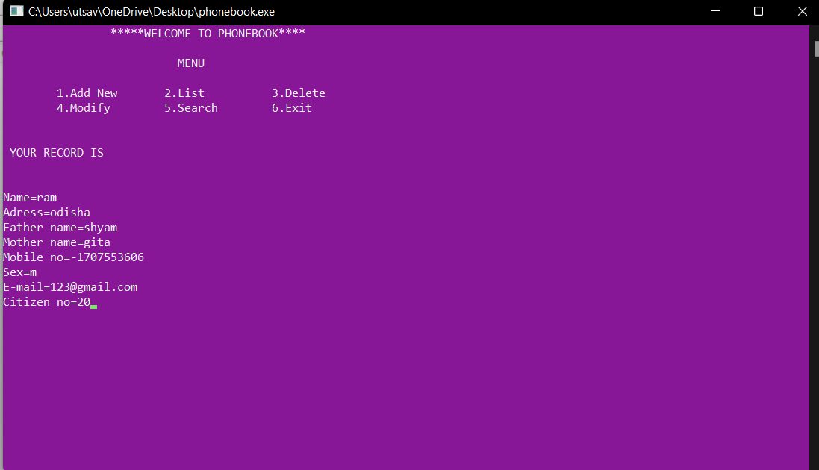
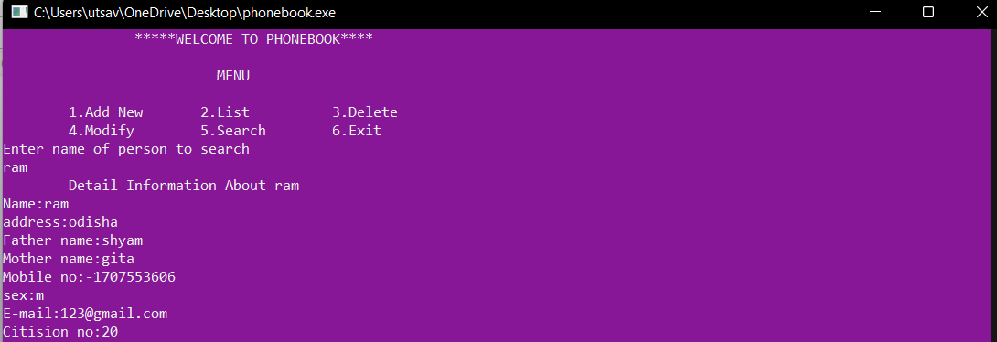

Slide 29
CONCLUSION
The application program has been successfully implemented using experimental cases and the language used – C. This application works for other functions that make it easy to search, delete, edit, and remember our peer information.

Slide 30

TEAM MEMBER
NAME :- Utsav kumar
Roll no :- CAM20026
Reg no :- 20010355
Branch :- CSE(AI & ML)
NAME :- Abhishek mahto
Roll no :- CAM20010
Reg no :- 20010341
Branch :- CSE(AI & ML)

Slide 31
TEAM MEMBER
NAME :- Keshav kamal
Roll no :- CAM20011
Reg no :- 20010342
Branch :- CSE(AI & ML)
NAME :- Anshu kumar
Roll no :- CAM20024
Reg no :- 20010353
Branch :- CSE(AI & ML)
NAME :- Saswat seth
Roll no :- CAM20023
Reg no :- 20010352
Branch :- CSE(AI & ML)

Slide 32

Thank You

